Slide 1


Climate Ready Places
Creating strong and healthy places to live, work and play
Presentation for students

Slide 2
Introduction
This presentation is part of the Climate Ready Places teaching pack for secondary school students.
The presentation serves as an introduction for students, to raise awareness of climate change and their understanding of climate adaptation issue.

Slide 3
What’s the difference between weather and climate?
Weather changes day by day, hour by hour and sometimes minute by minute!
When we refer to weather we are normally talking about what’s happening here and now – is it going to be raining, sunny, windy or snowing today or this week?
Climate describes typical weather conditions over much longer periods of time – usually at least thirty years.

Slide 4
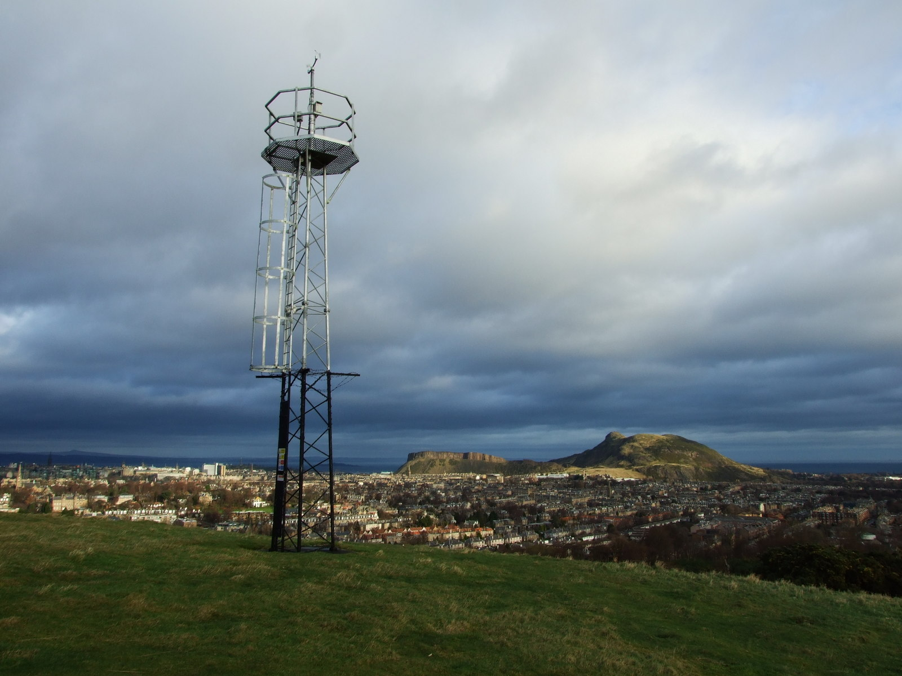
How do we know that climate is changing?
Scientists measure climate by recording details of weather conditions over many years at weather stations such as this one at Blackford Hill in Edinburgh.
Detailed records allows us to spot long term changes in temperature, rainfall and sea level and accurately estimate how our climate is likely to change in the future.
Photo © Copyright Kay Williams and licensed for reuse under this Creative Commons Licence.

Slide 5
How do we know that climate is changing?
Long term measurements tell us that Scotland’s climate is already changing. Over the last century temperatures have increased, sea levels have risen and rainfall patterns have changed including more heavy downpours.
These changes are expected to continue and increase over the coming decades. We can expect future changes in climate to be far greater than anything we have seen in the past.

Slide 6
How has Scotland’s climate changed already?
The last century has been a period of rapid climate change across Scotland.
Scientific records show that over the last few decades:
  Temperatures have increased - with the last decade the warmest ever recorded
  Rainfall patterns have changed - with increased rainfall and more heavy downpours
  Sea-level has risen around Scotland’s coast
  There have been fewer days with frost and snow cover

Slide 7
What changes are expected in the future?
Scientists expect that that the changes in climate recorded over the last century will continue and increase.
Key long-term climate change trends for Scotland are:
  Weather will remain variable, it may become more variable
  Typical summers will be hotter and drier
  Typical winter / autumn will be milder and wetter
  Sea level will continue to rise
  We can also expect to see:
  Increases in summer heat waves, extreme temperatures and drought
  Increases in heavy rainfall events
  Less frost and snowfall

Slide 8
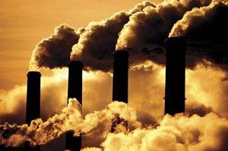
Why is our climate changing?
Every day millions of tons of the greenhouse gases such as carbon dioxide are emitted into the atmosphere as we burn fossil
fuels for energy, heat and
transport.
These greenhouse gases trap heat inside the earth’s atmosphere
and are causing the planet to warm causing rising temperatures,
sea level rise and changes in rainfall.

Slide 9
Why is our climate changing?
We can limit the amount of future climate change by reducing our greenhouse gas emissions, however the greenhouse gases that are already in the atmosphere and those that we are emitting today mean that our climate will continue to change for many years to come.

Slide 10
How will climate change
impact Scotland?
The following slides give some examples – you can also find more here: http://www.sniffer.org.uk/climatereadyplaces/impacts/?v=5

Slide 11


Buildings where we live, work and play
Buildings are damaged by severe weather like high winds and heavy rain. This can cause water to leak in through broken gutters and cracks in walls resulting in damp, mould and condensation.
Poor ventilation can also lead to buildings being too warm.
Many buildings will need to be completely changed to help them to cope with increased rain and higher temperatures.

Slide 12

Challenges for nature
Fish, birds, trees, plants and animals are vulnerable to changes in climate.
Warmer temperatures will increase the risk of new pests and diseases and species many struggle to adapt to changes in temperature and rainfall.

Slide 13

Increased risk of flooding
In many cases we have put hard surfaces and buildings next to rivers, meaning there is nowhere for rivers to flood safely when water levels are high.
Increases in rainfall mean that rivers and streets are now more likely to flood so we need to create safe spaces for flood water in our towns and cities.

Slide 14

Changes to our coast
Sea level rise will speed up coastal erosion and change the coast.
Some areas of our coast may be lost and others will be more vulnerable to flooding.

Slide 15

Disruption to travel
Roads, railways, stations and cycle paths can all be damaged by severe weather and sometimes have to be closed for repairs.
Heavy rain can also lead to more landslides, disrupting roads and damaging other infrastructure.
These impacts stop people from traveling to work and school and mean that businesses cannot deliver their products to customers.

Slide 16

People will need extra help
Our police, fire and health services face new challenges as a result of climate change. Increases in severe weather events and flooding will result in more requests for help to keep people and buildings safe.
People and communities affected by flooding can experience long periods of stress and difficulties as they work to repair their homes and businesses. At times people will need extra help to cope.

Slide 17
What can we do?
We can play our part in reducing greenhouse gas emissions and limiting the amount of future climate change.
We can build a climate ready future by taking action to make sure that our places and people are ready for the challenges of our changing climate.
The good news is that many of the things that will help us cope with the impacts of climate change are good for people and will help improve communities and create new opportunities.

Slide 18
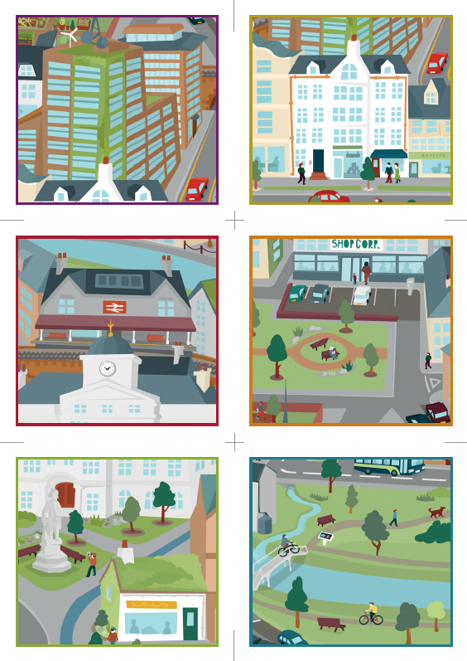
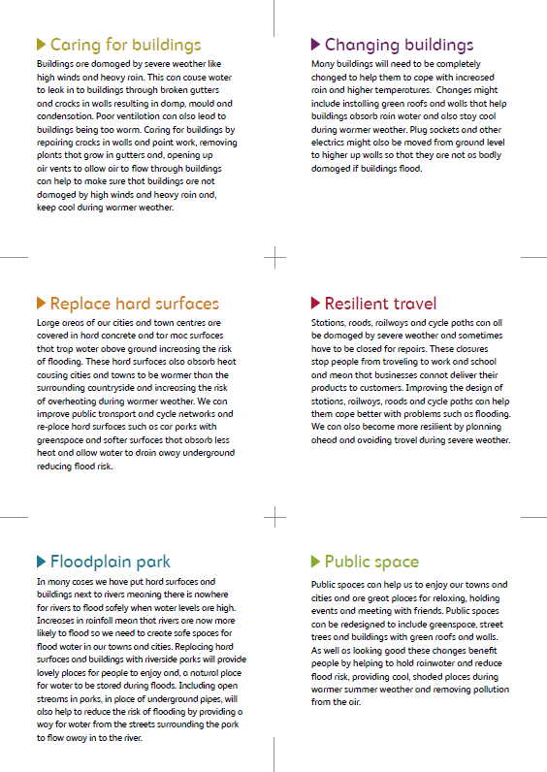
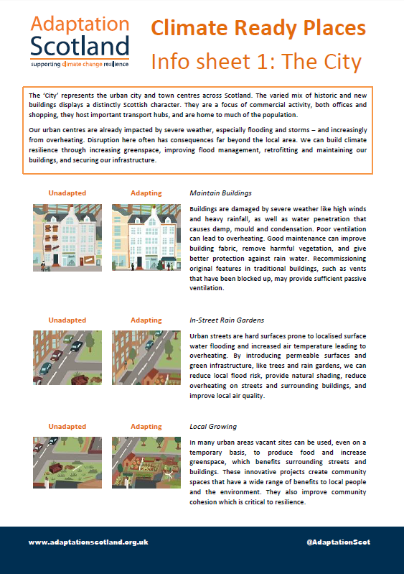
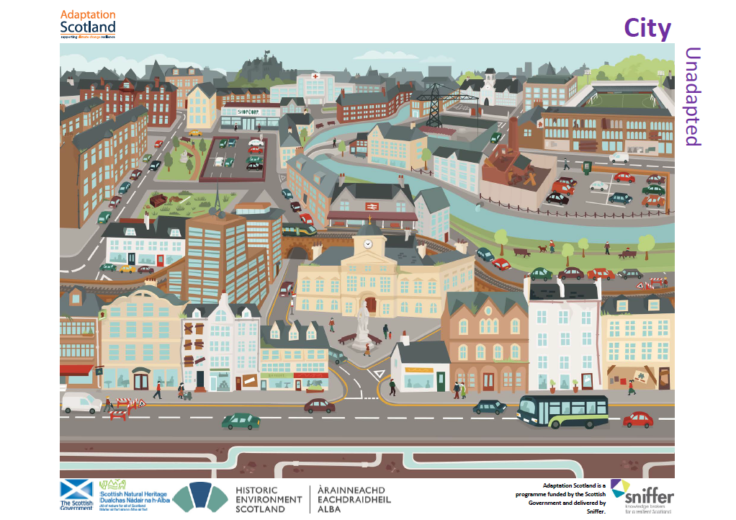
What can we do?
The upcoming activities in this lesson will ask you to think about some of the different ways that we can adapt to a changing climate in your town and around Scotland.

Slide 19
More information and resources
For more information about climate trends and projections for Scotland
visit: http://www.adaptationscotland.org.uk/why-adapt/climate-trends-and-projections
Visit the interactive climate ready places website to find out how different places across Scotland can adapt to climate change: http://www.sniffer.org.uk/climatereadyplaces/
Find out more about how you can reduce greenhouse gas emissions and help limit future climate change:
http://www.greenerscotland.org/

Slide 20
adaptationscotland@sniffer.org.uk
@adaptationscotland
www.adaptationscotland.org.uk
© Crown Copyright 2016. Contains public sector information licensed under the Open Government Licence v3.0. http://www.gov.scot/CrownCopyright Scottish Charity No SC022375, Company No SC149513. Registered in Edinburgh. Registered Office: 1 Exchange Crescent, Conference Square, Edinburgh, EH3 8UL

